Slide 1
Uncontrolled copy not subject to amendment
Airframes
Revision 1.00

Slide 2
Introduction
and
Chapter Index

Slide 3
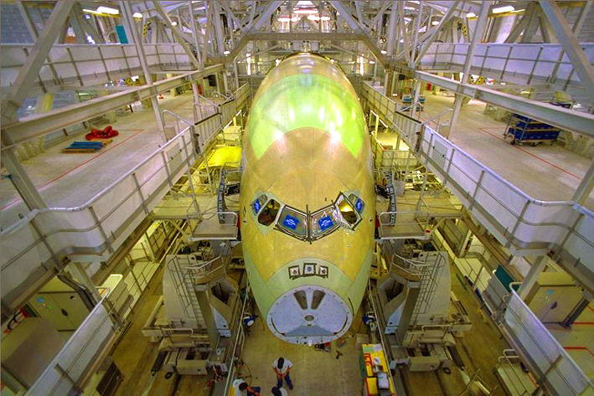

Slide 4
Introduction to Airframes
This subject provides an understanding of aircraft airframes and explores the principles of airframe design and their key features.
It considers aspects of engineering including materials, structural elements, methods of construction and manufacturing technology. The subject also develops an awareness of hydraulic systems.

Slide 5
Learning Outcomes
On completion of this subject, you should:
Be able to identify the main components of an aircraft and understand how the underlying structure is made up.
Be able to identify the main materials used in aircraft construction, where they are used and what properties are beneficial in supporting the design.
Understand the techniques and tools used in the manufacture of an airframe.
Understand the loads and forces acting upon the fuselage and the methods of construction used in creating the fuselage.
Understand the main functions of the wing and tailplane and the methods of construction employed.
Be able to identify the main components of aircraft hydraulic & pneumatic systems and recognise their associated functions.
Understand the types of undercarriage, their function and positioning.

Slide 6
Index of Chapters
Chapter 1: Airframe Design | Chapter 2: Materials
Chapter 3: Manufacturing Technology | Chapter 4: Fuselage
Chapter 5: Wing & Tailplane | Chapter 6: Hydraulics & Pneumatics
Chapter 7: Undercarriage

